Slide 1


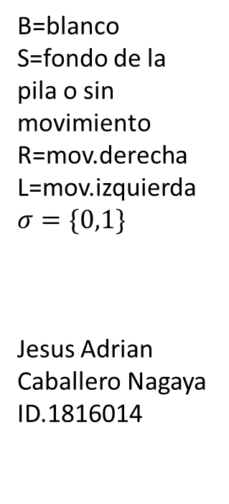

(0,B)
(0,B)
(0,B)
(1,B)
(4,B)
(j,B)
(j,B)(R,S)
(a,B)
(a,B)(R,S)
(c,B)
(c,B)(R,S)
(n,B)
(n,B)(R,S)
(j,B)
(j,B)(R,S)
(a,B)
(a,B)(R,S)
(c,B)
(c,B)(R,S)
(n,B)
(n,1)(R,R)
(0,B)
(R,R)
(0,B)(R,S)
(1,B)(R,S)
(4,0)(R,R)
($0$, $σ$)
(0,B)(R,S)
(1,B)
(1,B)(R,S)
(4,B)
(4,B)(R,S)
(0,B)
(0,B)(R,S)
(1,B)
(1,B)(R,S)
(4,B)
(4,0)(R,R)
(0,B)
(0,B)(S,L)
($0$, $σ$)
(0, $σ$)(S,L)
(0,B)
(0,B)(S,R)
(0,0)
(0,0)
(0,B)(R,S)
(1,0)
(1,0)(R,S)
(4,0)
(a,B)(R,S)
(B,1)
(B,B)(S,S)
B=blanco
S=fondo de la pila o sin movimiento
R=mov.derecha
L=mov.izquierda$σ=\{0,1\}$
Jesus Adrian Caballero Nagaya ID.1816014

